Slide 1
Training for Medical education via innovative eTechnology
MediTec
WP6
Management
23.02.2018

Slide 2
How to manage the project MediTec successfully?
i. Remarks – experiences, needs, …
ii. Tasks of the WP
iii. Steering committee
iv. Problem: last payment (10% of means)
v. Partnership agreement
vi. Staff costs
vii. Travel costs, costs of stay

Slide 3
i. Remarks – experiences, needs, …
WP for solving project tasks
our aims for improving educational process
The grant is our problem !!!
There are several limitations due to:
rules of EACEA in Brussels, guidelines
rules of JO/IQ/IR financial systems,
rules of DE/CZ/SK/MA financial systems
DE (DE rules, Saxony rules and
HTWK rules : Central administration in HTWK ,Rectorate of HTWK, §§§)
Monitoring visits, reporting, auditing (Consequences, performance of audits, proof of payments, co-financing,….. )
Changes in project implementation

Slide 4
ii. Tasks of the WP Management
means:
overall responsibility for success of entire project
financial and other reports regularly sent from local coordinators to grant holder
budgetary control
responsibility of partners for implementation and project support by local authorities
adequate and fair participation of all partners
Coordination of meetings
Management of project activities

Slide 5
6.1 Coordination meetings
- for ensuring
efficient implementation and quality,
inclusion of all consortium members
communication between partners.
HTWK performs overall project management and coordination, But only together with the local coordinator and WP leaders and off course all partners
LC and WPL are responsible for local management/organization of activities and cooperating in steering committee
- all partners performs accounting & submit data via local coordinator / WP leader to HTWK.

Slide 6
6.2 Controlling of the project activity, Monitoring and evaluation of results
All partners will work together on:
Control of project activities
by LC and WPL:
monthly/weekly control of project quality and
results summarized and documented
activities evaluated and
Results and reports after each activity, sent to the HTWK

Slide 7
6.3 Reporting and control of the budget
budget calculation & control, all local coordinators are responsible
by LC + WPL + responsible person for financial report, controlled by project coordinator
financial documentations required for transparency in original
use of financial means before starting + after performing activities, in order to ensure successful perform
financial reports after each activity (invoices and calculations must be sent in original)

Slide 8
iii. Steering, quality and technical committee
Steering committee for activities’ coordination
SC is responsible for many issues, for example:
strategic decisions for project performance & implementation;
management of project activities;
internal quality control, assessment, monitoring and reporting;
conversion project applications to a practical plan.
conflict management;
budgeting;
evaluation of the project results

Slide 9
SC
4 EU university partners including the coordinator
JO-LC, 1 IQ-LC-, 1 IR-LC-university partners,
each with 1 voice
WPL & coordinator give overview on WP quality & financial planning & project status during meetings,
meeting 2x per year
agreements and results of meetings published in project website/ mails.
decisions of SC legally binding to all parties concerning project implementation
decisions of SC recommendations for financial questions
with respect to Grantholder
due to financial responsibility of legal representative,

Slide 10
- decisions of SC legally binding to all parties
concerning financial questions of all other consortium members
- coordinator leads SC meetings & prepares proposals to SC.
- SC sessions and decisions
open and/or during project meetings
or closed
or in writing by a circular resolution (if all agree).
- decisions valid via two-thirds (2/3) voice of its members
in event of a tie, the coordinator shall cast the deciding voice.
- taking notes during meetings
- decisions of SC distributed to all parties without delay.
e.g. via website
decisions will collected and kept by the coordinator

Slide 11
iv. Problem: last payment (10% of means)
only after successful Final Report
may be reduced
but: delivering all invoices

Slide 12
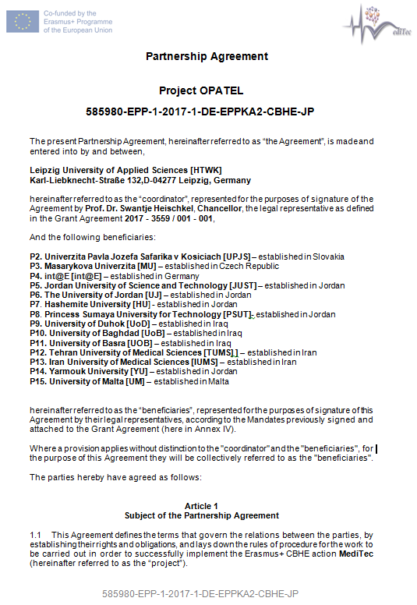
v. Partnership agreement

Slide 13
